Slide 1

Cold Email Generator: Project Overview
This presentation explores the technical details and features of a cold email generator designed for developers and engineers looking to streamline their outreach efforts. The system utilizes data, templates, and automation to create professional and targeted cold emails.
Shubham Tiwari

Slide 2
Problem Statement:
Individuals often face challenges in managing effective communication, especially when reaching out to multiple recipients with personalized messages.
Crafting tailored emails, ensuring their timely delivery, and organizing data for efficient follow-ups can be time-consuming and overwhelming. Additionally, most available tools lack user-friendly integration capabilities and adaptability, making it difficult to stay efficient and future-ready.
There is a need for a solution that:
Simplifies the generation of customized emails based on predefined templates and personal data.
Facilitates seamless email delivery through integrations with external tools like SMTP or APIs.
Enables efficient storage and retrieval of structured data for better organization and follow-ups.
Offers modular architecture for easy updates and adaptability to evolving needs.

Slide 3
Key Features
Email Generation
Email Delivery
Database Integration
Extensibility
Generate customized cold emails using predefined templates and data such as job titles and descriptions, ensuring each email is personalized.
Integrate with external tools, like SMTP services or APIs, to send emails directly, making the process seamless and efficient.
A modular architecture allows for easy updates, enhancements, and the addition of new features, keeping the system adaptable and future-proof.
Leverage vectorized storage through chroma\_db.ipynb or vectorstore files to handle structured data, ensuring efficient querying and retrieval.

Slide 4

Workflow: A Step-by-Step Guide
1
Input
The user provides job titles or descriptions through a CSV file or a user interface, defining the target audience for the emails.
2
Processing
Input data is vectorized, and the system generates email content by utilizing predefined templates and stored data. The system applies data-driven insights to customize each email.
3
Output
Generated emails are either saved locally for review or sent directly to recipients via the email-sending logic, ensuring the messages are delivered efficiently.

Slide 5
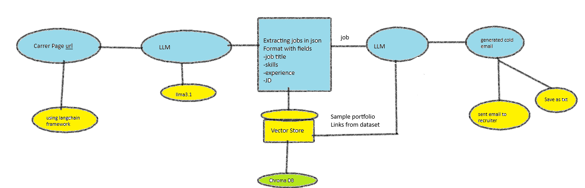
System Architecture

Slide 6
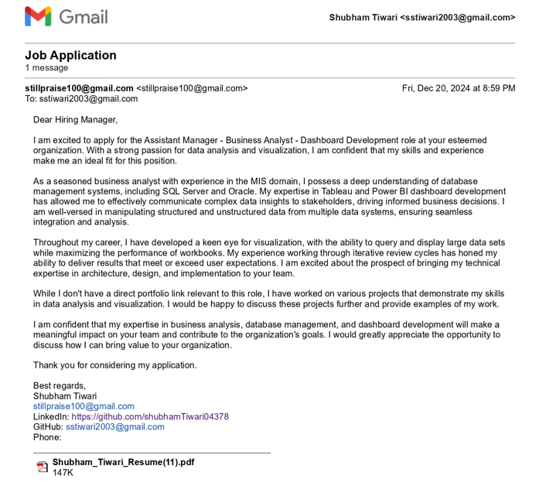
Output

Slide 7
Future Scope
1. Resume Builder Module
Allow users to generate personalized resumes tailored to specific job descriptions or industries
2. Alternative Cover Letter Generation
Offer an option for users to choose between multiple styles of cover letters, e.g., formal, creative, or concise.
3.Voice-to-Email Integration: Enable users to dictate job descriptions or application emails using voice recognition systems, integrating with platforms like Whisper for transcription and generation.

Slide 8



Conclusion
Efficiency
1
Automate the generation and delivery of cold emails, saving time and effort.
2
Data-driven
Utilizes data and templates for targeted and personalized emails.
Customization
3
Tailored messages based on recipient roles and interests.

